Slide 1
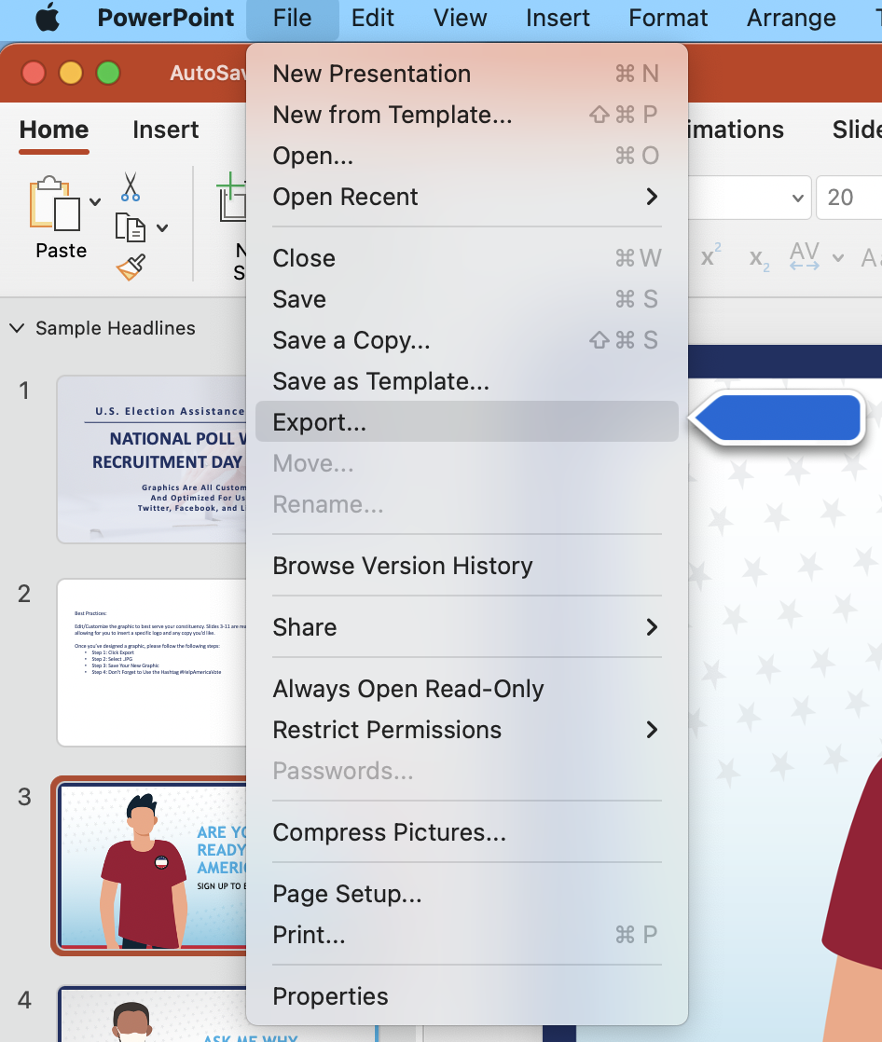
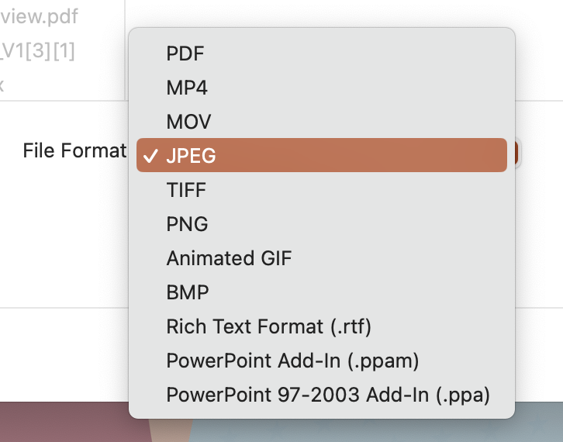
For Mac Users: Best Practices: Step-by-Step Guide To Customizable Graphics
Edit/Customize the graphic to best serve your constituency. There are two versions of each graphic, one that is ready to publish and one that is customizable – allowing for you to insert a specific logo and any copy you’d like.
Once you’ve designed a graphic, please follow the following steps:
Step 1: Click File, then Export
Step 2: Select .JPG
Step 3: Save Your New Graphic
Step 4: Don’t Forget to Use the Hashtag #HelpAmericaVote
Step 1
Step 2

Slide 2
For Windows Users: Best Practices: Step-by-Step Guide To Customizable Graphics
Edit/Customize the graphic to best serve your constituency. There are two versions of each graphic, one that is ready to publish and one that is customizable – allowing for you to insert a specific logo and any copy you’d like.
Once you’ve designed a graphic, please follow the following steps:
Step 1: Click File, then Export
Step 2: Click Change File Type
Step 3: Under Image File Types, Select .JPG
Step 4: Save Your New Graphic
Step 5: Don’t Forget to Use the Hashtag #HelpAmericaVote
Step 1
Step 2
Step 3

Slide 3
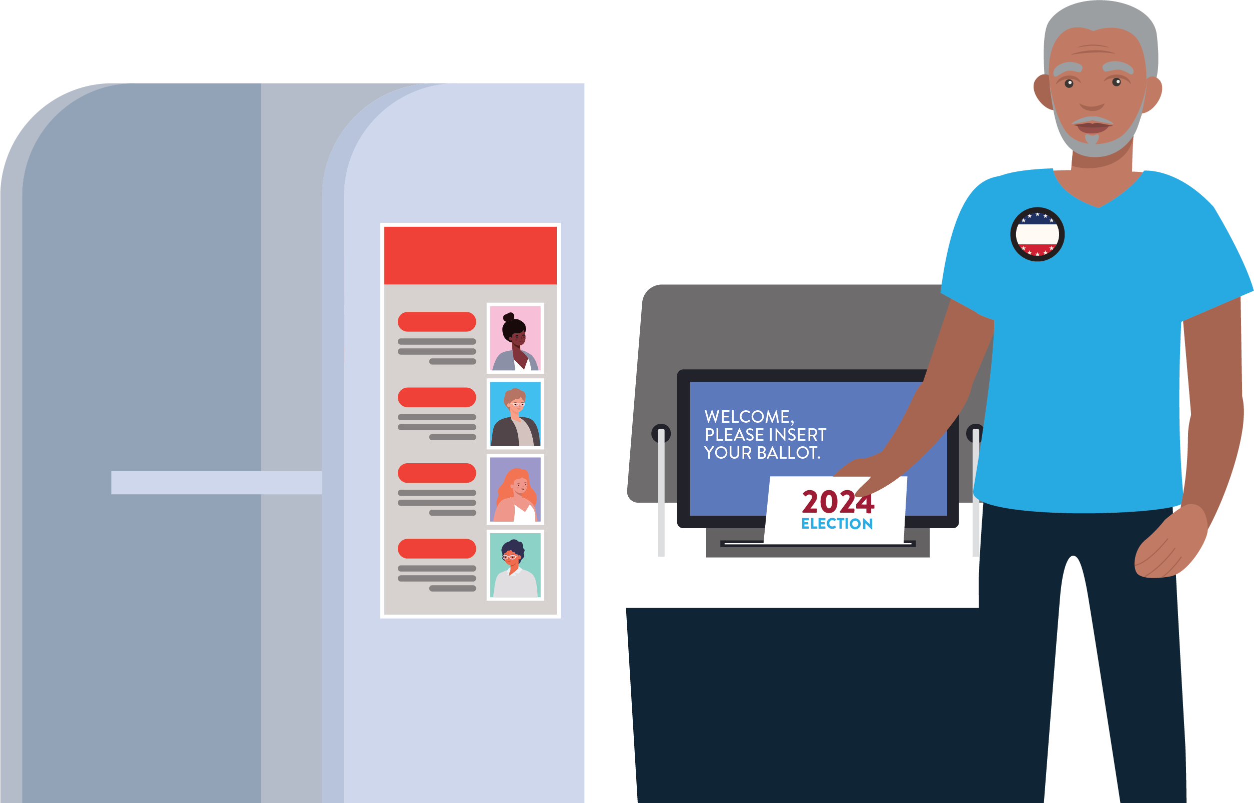
Your Text Goes Here
Your Subtext Goes Here
Your Logo Goes Here

Slide 4
National Poll Worker Recruitment Day

Slide 5
Your Text Goes Here
Your Subtext Goes Here
Your Logo Goes Here

Slide 6
National Poll Worker Recruitment Day

Slide 7
Your Text Goes Here
Your Subtext Goes Here
Your Logo Goes Here

Slide 8
National Poll Worker Recruitment Day

Slide 9
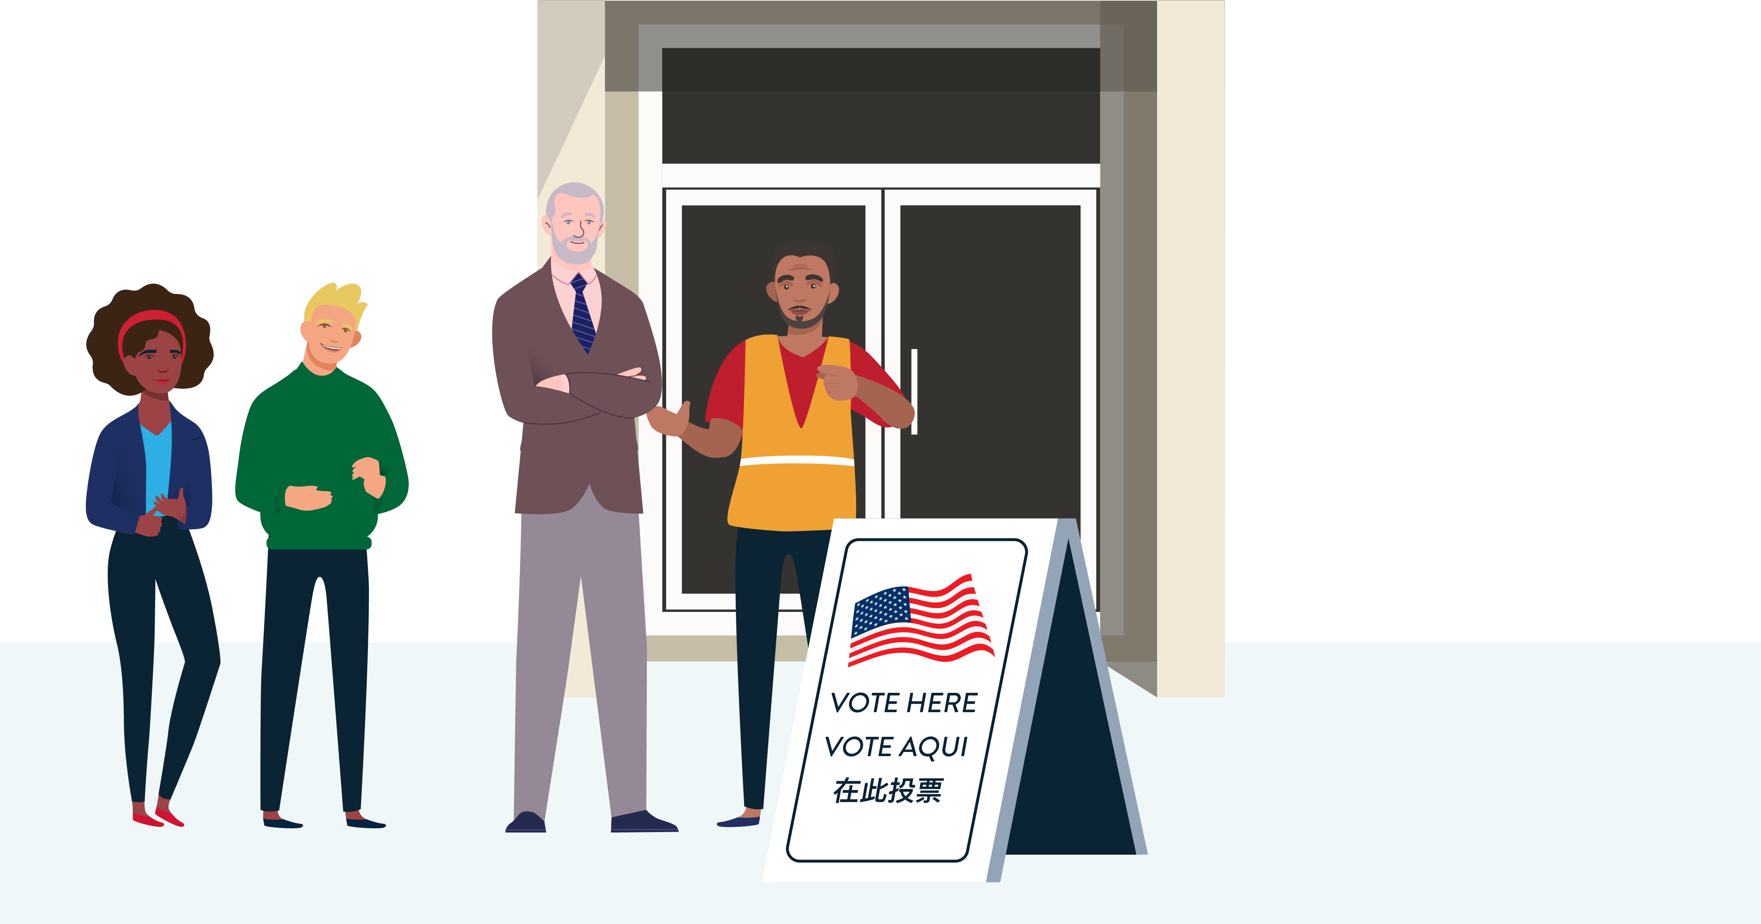
Your Text Goes Here
Your Subtext Goes Here
Your Logo Goes Here

Slide 10
National Poll Worker Recruitment Day
Your Logo Goes Here

Slide 11
Your Text Goes Here
Your Subtext Goes Here
Your Logo Goes Here

Slide 12
National Poll Worker Recruitment Day

Slide 13
Your Text Goes Here
Your Subtext Goes Here
Your Logo Goes Here

Slide 14
National Poll Worker Recruitment Day

Slide 15
Your Text Goes Here
Your Subtext Goes Here
Your Logo Goes Here

Slide 16
National Poll Worker Recruitment Day

Slide 17
Your Text Goes Here
Your Subtext Goes Here
Your Logo Goes Here

Slide 18
National Poll Worker Recruitment Day

Slide 19
Your Text Goes Here
Your Subtext Goes Here
Your Logo Goes Here

Slide 20
National Poll Worker Recruitment Day

