Slide 1
2024 ‘I VOTED’ Sticker Contest
Presented by
Currituck County Board of Elections

Slide 2
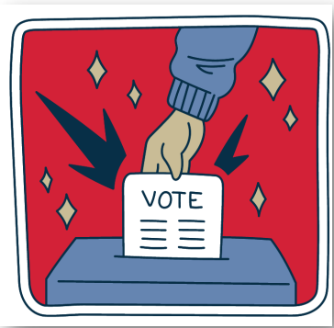
The 2024 Election 11/5/2024
• This year is a presidential election year.
Historically, presidential elections have greater voter turnout.
• In North Carolina, we will also elect a Governor, Lieutenant Governor, Secretary of State, and many more offices.
• There are 3 ways to vote:
1. You can vote Early, in-person.
2. You can vote on Election Day, in-person
3. You can vote by mail (absentee voting)
• Early Voting is between Oct. 17-Nov. 2.
• Election Day is Nov. 5
• Photo ID is needed to vote in our state now.
• Learn more about North Carolina Elections here https://www.ncsbe.gov/voting/upcoming-election#genera

Slide 3
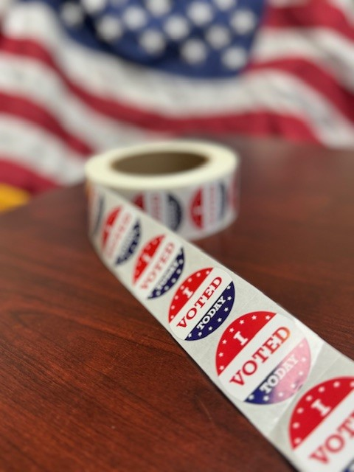
OVERVIEW
Calling all Currituck County young artists!
You are invited to participate in the 2024 'I Voted' Sticker Contest. Any Currituck County artist up to age 18 is invited to submit a sticker design by July 19. Top artists and the winning sticker designer will have an opportunity to be recognized by the Currituck County Board of Elections and the Currituck County Board of Commissioners. The winning sticker will be distributed during the November Presidential Election to all voters in Currituck County. Learn more about design guidelines and submission directions by calling the Currituck County Board of Elections at: (252) 232-2525.
or visit our page at:
https://currituckcountync.gov/board-of-elections/
CALLING ALL YOUNG ARTISTS!
YOUR DESIGN HERE
Currituck County Board of Elections: 2024 Youth “I Voted” Sticker Contest

Slide 4
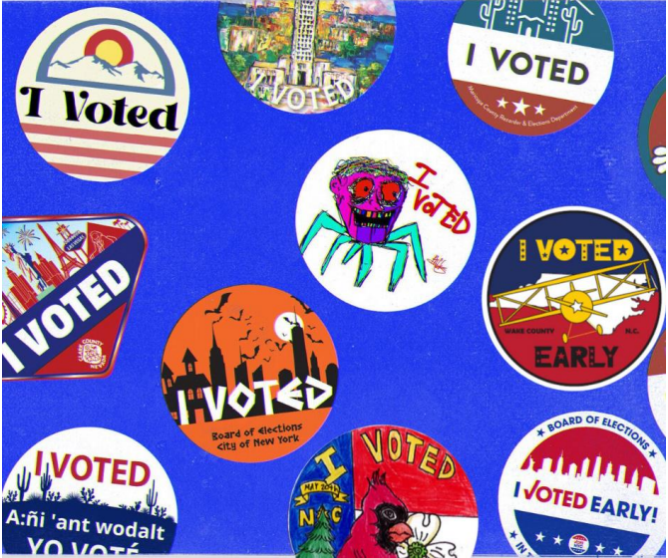
Election Sticker Examples

Slide 5
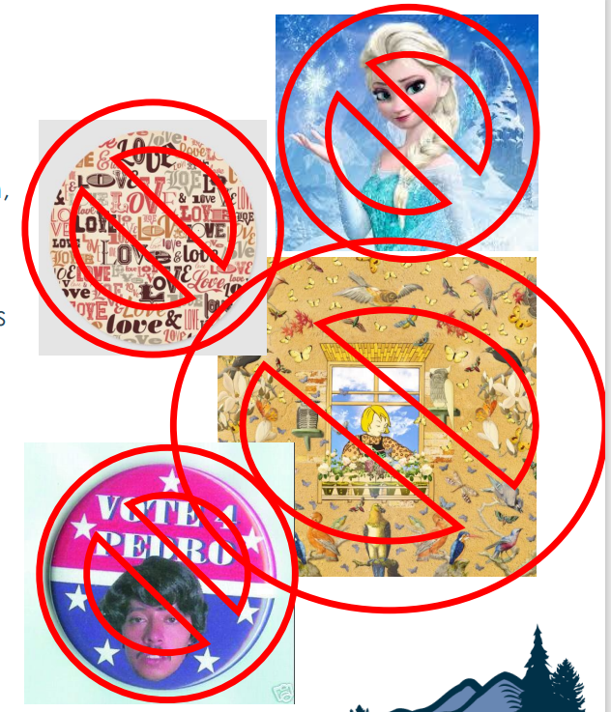
Non-Examples
USE YOUR OWN ART
• Avoid using licensed characters, cartoons, and images that belong to others. Create your own, unique artwork!
CHOOSE A FEW WORDS CAREFULLY
• Pick words and don't use too many. Election stickers are small and lots of text are hard to read. Your sticker must include the phrase "I Voted“
3) SIMPLIFY DESIGNS
• A small sticker will not show tiny details. Think about what would look good on a sticker you see from farther away. What will stand out?
ENCOURAGE VOTING
• Stickers should be non -partisan. Your sticker should encourage people to vote. Don't tell voters specific candidates or issues to vote for.

Slide 6
DIRECTIONS
WHEN: Artwork will be collected between June 1 – July 19, 2024.
DEADLINE: July 19, 2024
HOW:
1. Download the Sticker Design Submission Form from Elections – Currituck County (currituckcountync.gov) or pick up a form at any Currituck County Libraries.
2. Print and draw on the paper with any medium, or create a digital design. Make sure it includes the phrase “I Voted”.
3. Print and sign or download a digital copy of the Release Form.
4. Send you artwork – Photo, PDF, JPEG and your signed Release Form to Kimberly.twine@currituckcountync.gov or mail to Currituck County Board of Elections PO Box 177, Currituck, NC 27929

Slide 7
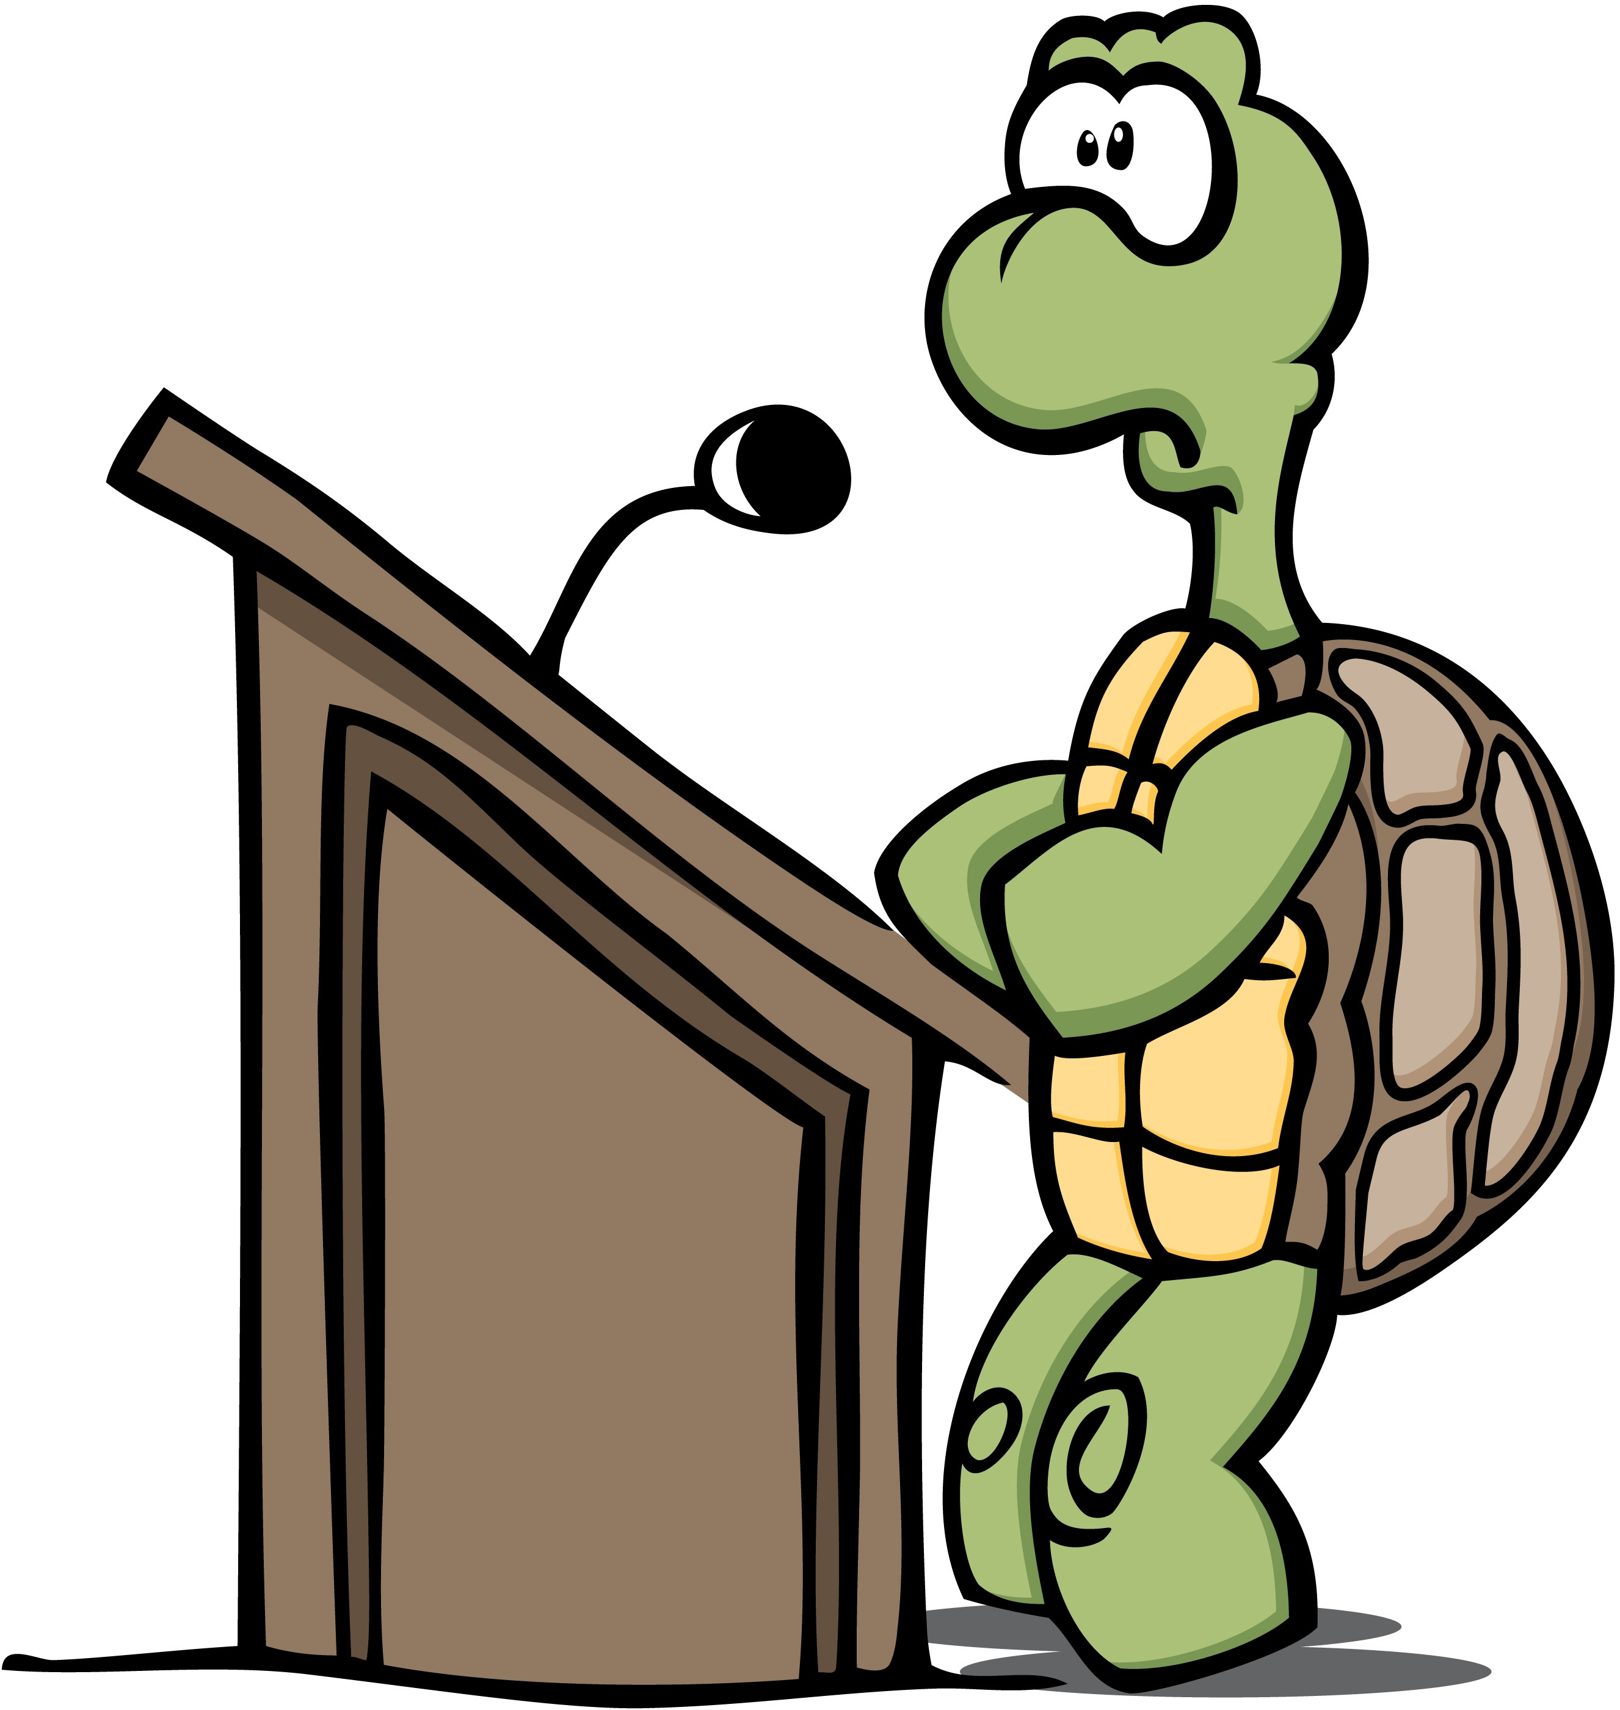
ACTIVITES FOR THE CLASSROOM AND BEYOND
Write about the symbols, messages, or themes you chose for your design. Explain why voters might connect with your art and how your sticker encourages people to vote.
Create a speech encouraging people to vote for issues you care about. Make sure to use evidence, data, and stories to support your claims.
Create a video sharing your design to your friends and family. Explain what your sticker means and why people should vote for your design. Remind people to vote for your unique art!
Ask an adult to research the ballot, issues, and candidates for the November election (local race or national). Choose one (ballot, issues, or candidate) and design a campaign flyer.
Calculate the year you will be eligible to vote. Is it a Mid-term or General Election year?

Slide 8
Classroom Standards
Elementary School:
1st Grade: 1 B.1.3 Explain how the artistic expressions of diverse people and cultures contribute to communities around the world.
2nd Grade: 2.C&G.1 Understand how freedom, equality, and democracy contribute to the government of America.
3rd Grade: 3.B.1 Understand how values and beliefs of individuals and groups influence communities.
4th Grade: 4.B.1.1 Explain sow traditions, social structure, and artistic expression have contributed to the unique identity of North Carolina.
5th Grade: 5.H.1.6 Explain the significance of national symbols and traditions from various perspectives.
Middle School:
6th Grade: 1.1.7 Construct arguments consisting of multiple claims with evidence from sources and attention to disciplinary detail.
7th Grade: 7.B.1.2 Explain how values and beliefs affect human rights, justice, and equality for different groups of people.
8th Grade: 8.C&G.1 Understand how democratic principles have influenced the government structure and policies of North Carolina and the nation.
High School:
American History 1: AH1.H.4 Analyze how conflict and compromise have shaped politics, economics and culture in the United States.

