Slide 1
State Incident Response Support to Locals
“We don’t stop an election; we figure out how to proceed.”
NASED Winter Conference ● February 2, 2025

Slide 2
The Makeup of A Response
Build
Respond
Evaluate

Slide 3
The Makeup of A Response
BUILD
Respond
Evaluate
Monthly partner meetings
Tabletop the Vote
Statewide Exercise w/Emergency Management
Conferences
Emergency Response HUB and New Director Training Module
Huddles
Stationed at EOC for elections
Security Briefings
Field Specialists
ARKs (Attack Response Kits)

Slide 4
The Makeup of A Response
Build
Respond
EVALUATE
Post-exercise hot washes & after actions
Post-election lessons learned
Return to “Build” steps

Slide 5
Response Mode
Build
RESPOND
Evaluate
Absentee by mail delayed (UOCAVA 9/20; CIV 9/24)
Wed./Th., 9/25-27: NCSL in Asheville
Friday, 9/27: Helene strikes
19 days until Early Voting starts
39 days until Election Day
Saturday, 9/28: Communication and coordination efforts start
Pipe bursts at NCSBE (unrelated)

Slide 6
Response Mode
Build
RESPOND
Evaluate
Monday, 9/30:
8 AM: 14 county election offices unable to open
9 AM: Post-storm Assessment & Response Meetings start
2 PM: NCEM Briefing
4 PM: Emergency State Board Meeting held (Resolution #1)

Slide 7
Response Mode
Build
RESPOND
Evaluate
Tuesday, 10/1:
9 AM: Post-storm Assessment & Response Meetings
10:30 AM: Press Conference
Wednesday, 10/2:
9 AM: Post-storm Assessment & Response Meetings
11 AM: Meet w/Senator Tillis’ staff
2:30 PM: Meet w/legislative staff

Slide 8
Response Mode
Build
RESPOND
Evaluate
Thursday, 10/3:
9 AM: Post-storm Assessment & Response Meetings
1 PM: NCEM Touchpoint
2:30 PM: Resolution #2 work session
3:30 PM: USPS coordination meeting
5:30 PM: CISA meeting

Slide 9
Response Mode
Build
RESPOND
Evaluate
Friday, 10/4:
9 AM: Post-storm Assessment & Response Meetings
10:30 AM: Resolution #2 work session
11:30 AM: Call with board member in affected county
1:30 PM, 4:30 PM, and Saturday: Review Resolution #2 with board members

Slide 10
Response Mode
Monday, 10/7:
8 AM: Call with ES&S
All offices are open
9 AM: Post-storm Assessment & Response Meetings
10 AM: Monday Morning Kickoff
11 AM: State Board Meeting Emergency Resolution
1:15 PM: Availability to affected counties
2 PM: Press Conference
3 PM: CBS News
4 PM: NCEM Touchpoint
Build
RESPOND
Evaluate

Slide 11
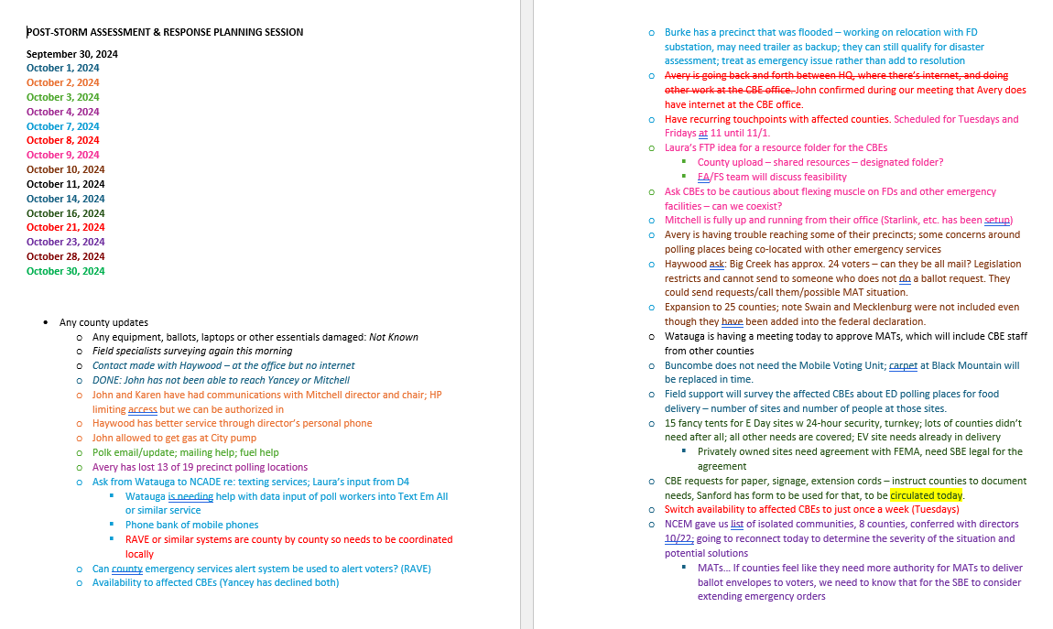
Response Mode

Slide 12
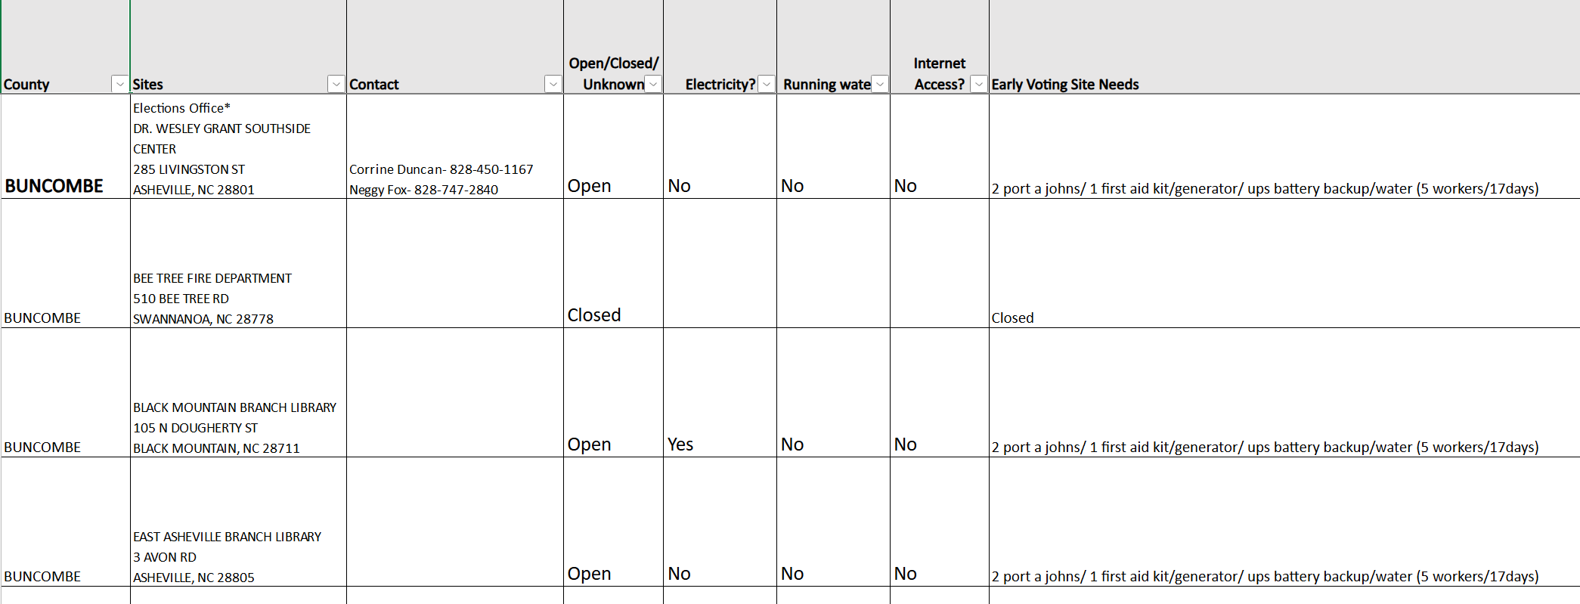
Response Mode

Slide 13
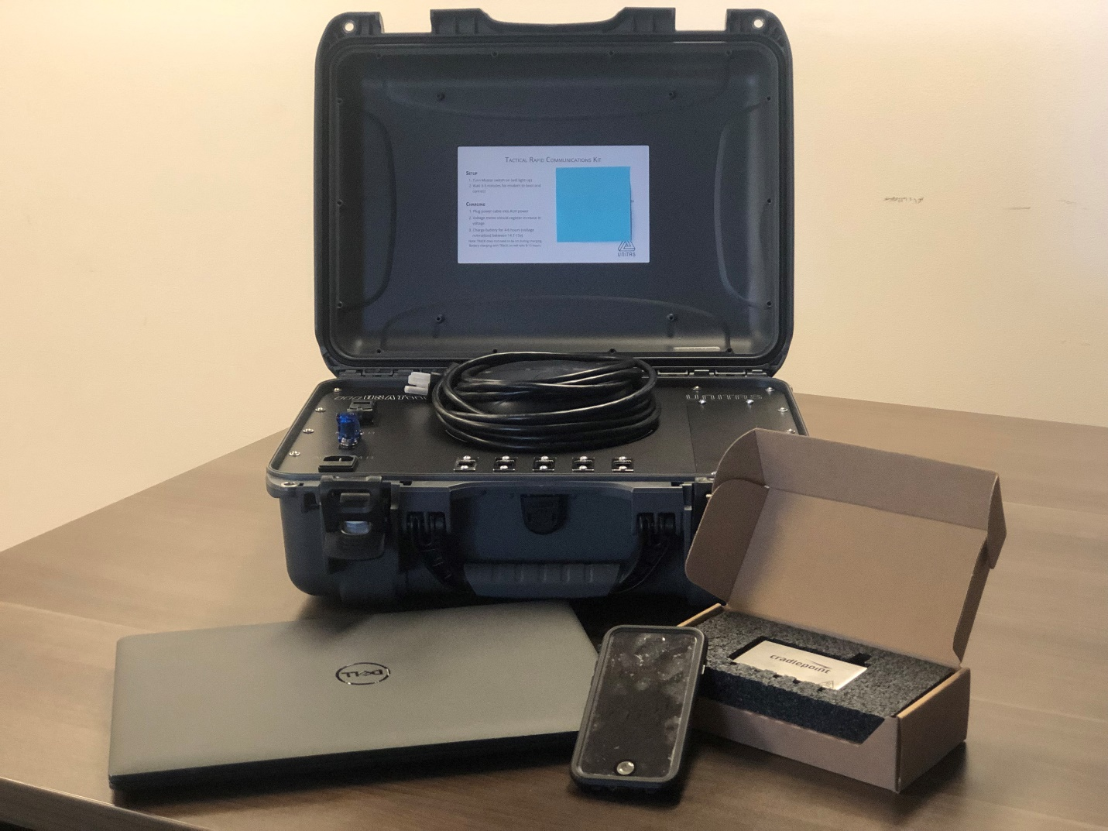
Response Mode
Attack Response Kits (ARKs)
“Out Past Curfew” Letters
Authorization for gas
Old-school communication methods & outreach
Paper backups and manual methods
Over communicate
Injured player on the field
Report outs to reduce meetings
Personal situations to address

Slide 14
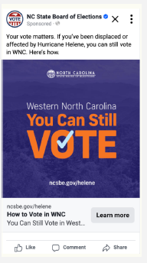
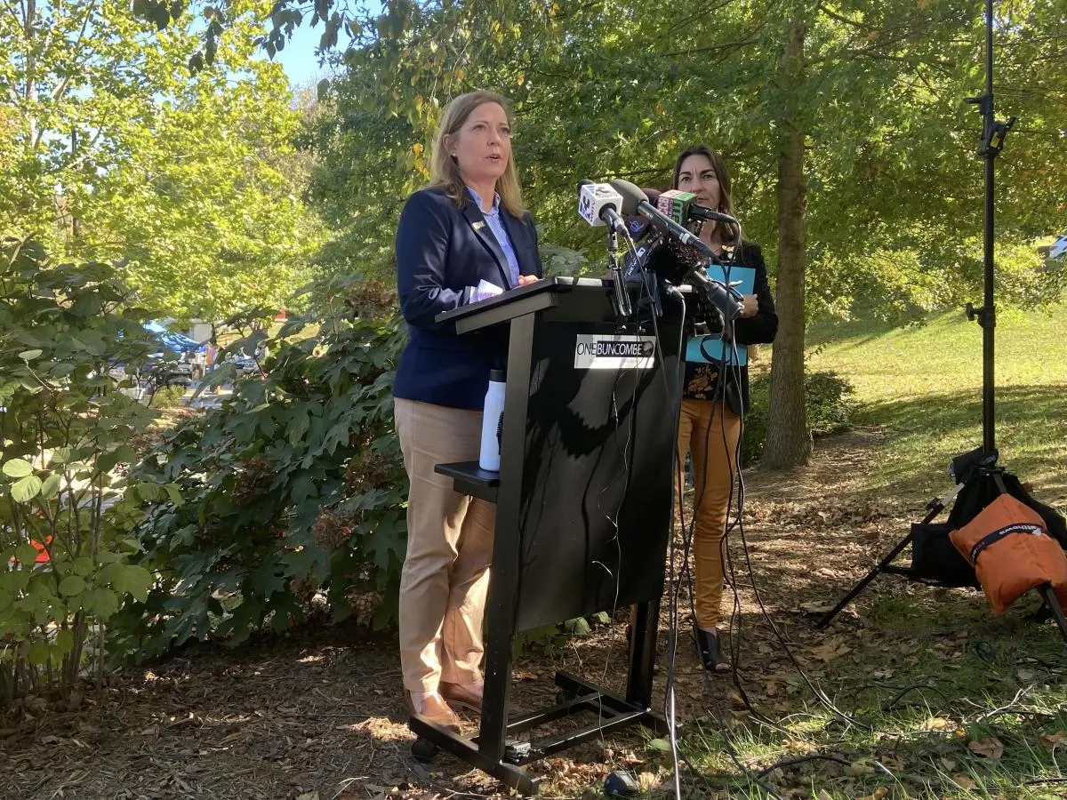
Response Mode
Press conferences
Media interviews (focus on local)
Print ads
Social media
Flyers
Dedicated webpage
Display banners
Sandwich boards

Slide 15
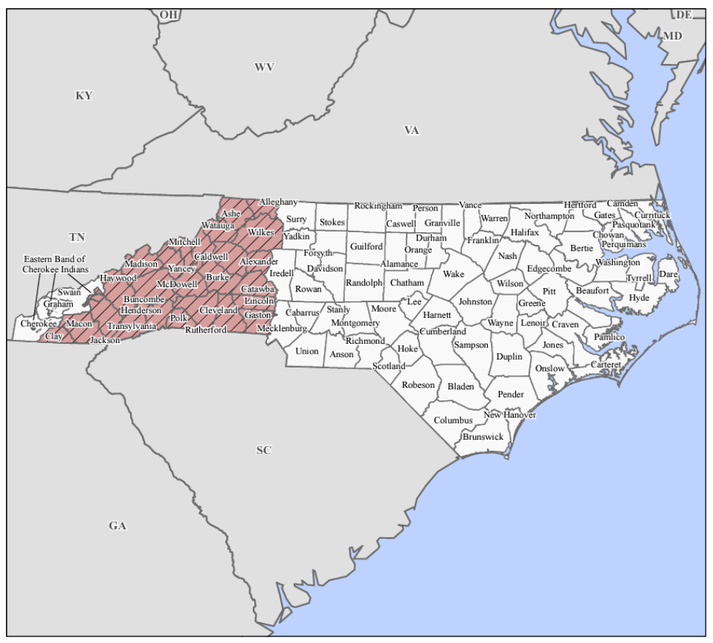
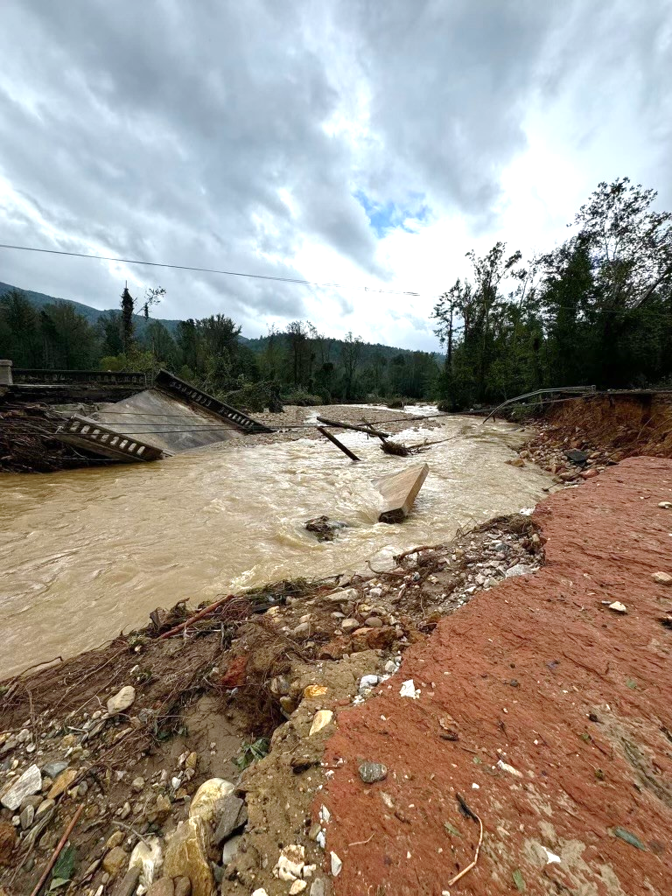
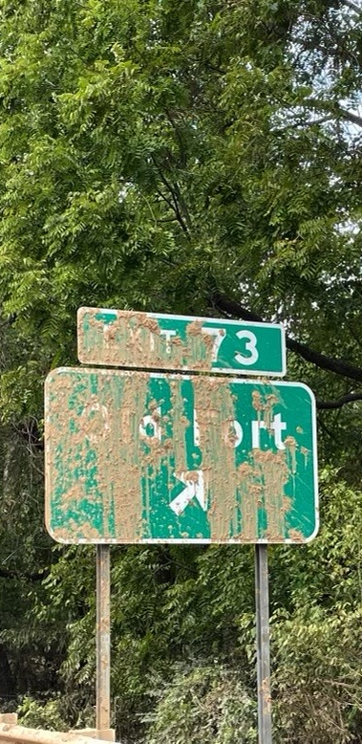
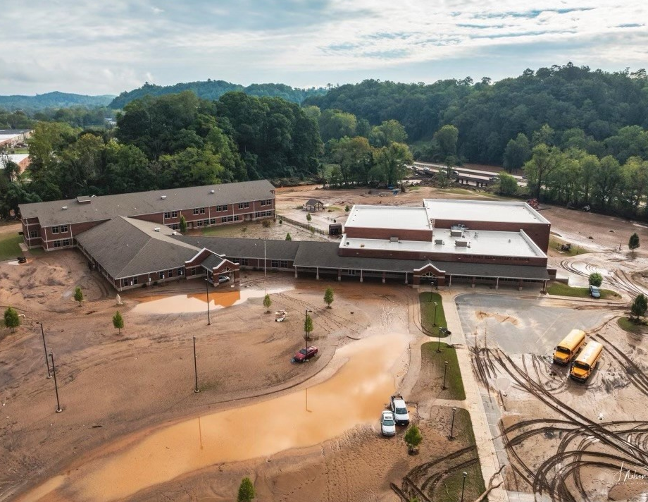
Early voting opened in ALL North Carolina counties on October 17, 2024 – 19 days after Hurricane Helene moved through WNC
76 of 80 planned early voting sites in disaster declared counties with power
Legislation required 4 additional sites in final week (Henderson, McDowell)
Delivering Voting Through Helene & High Water

Slide 16
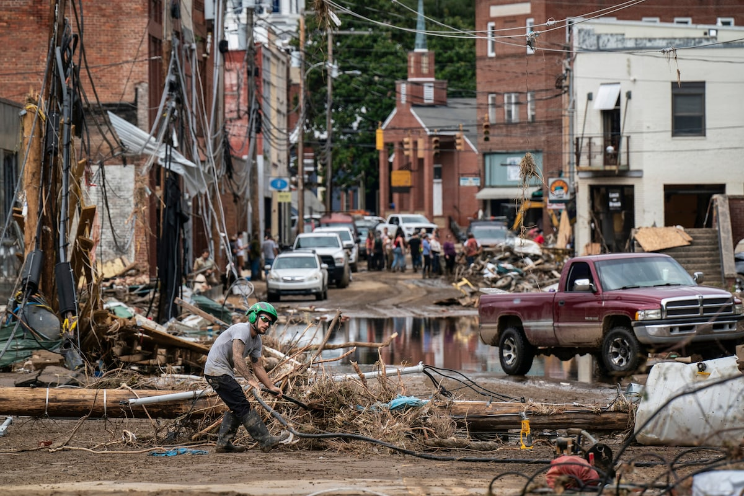
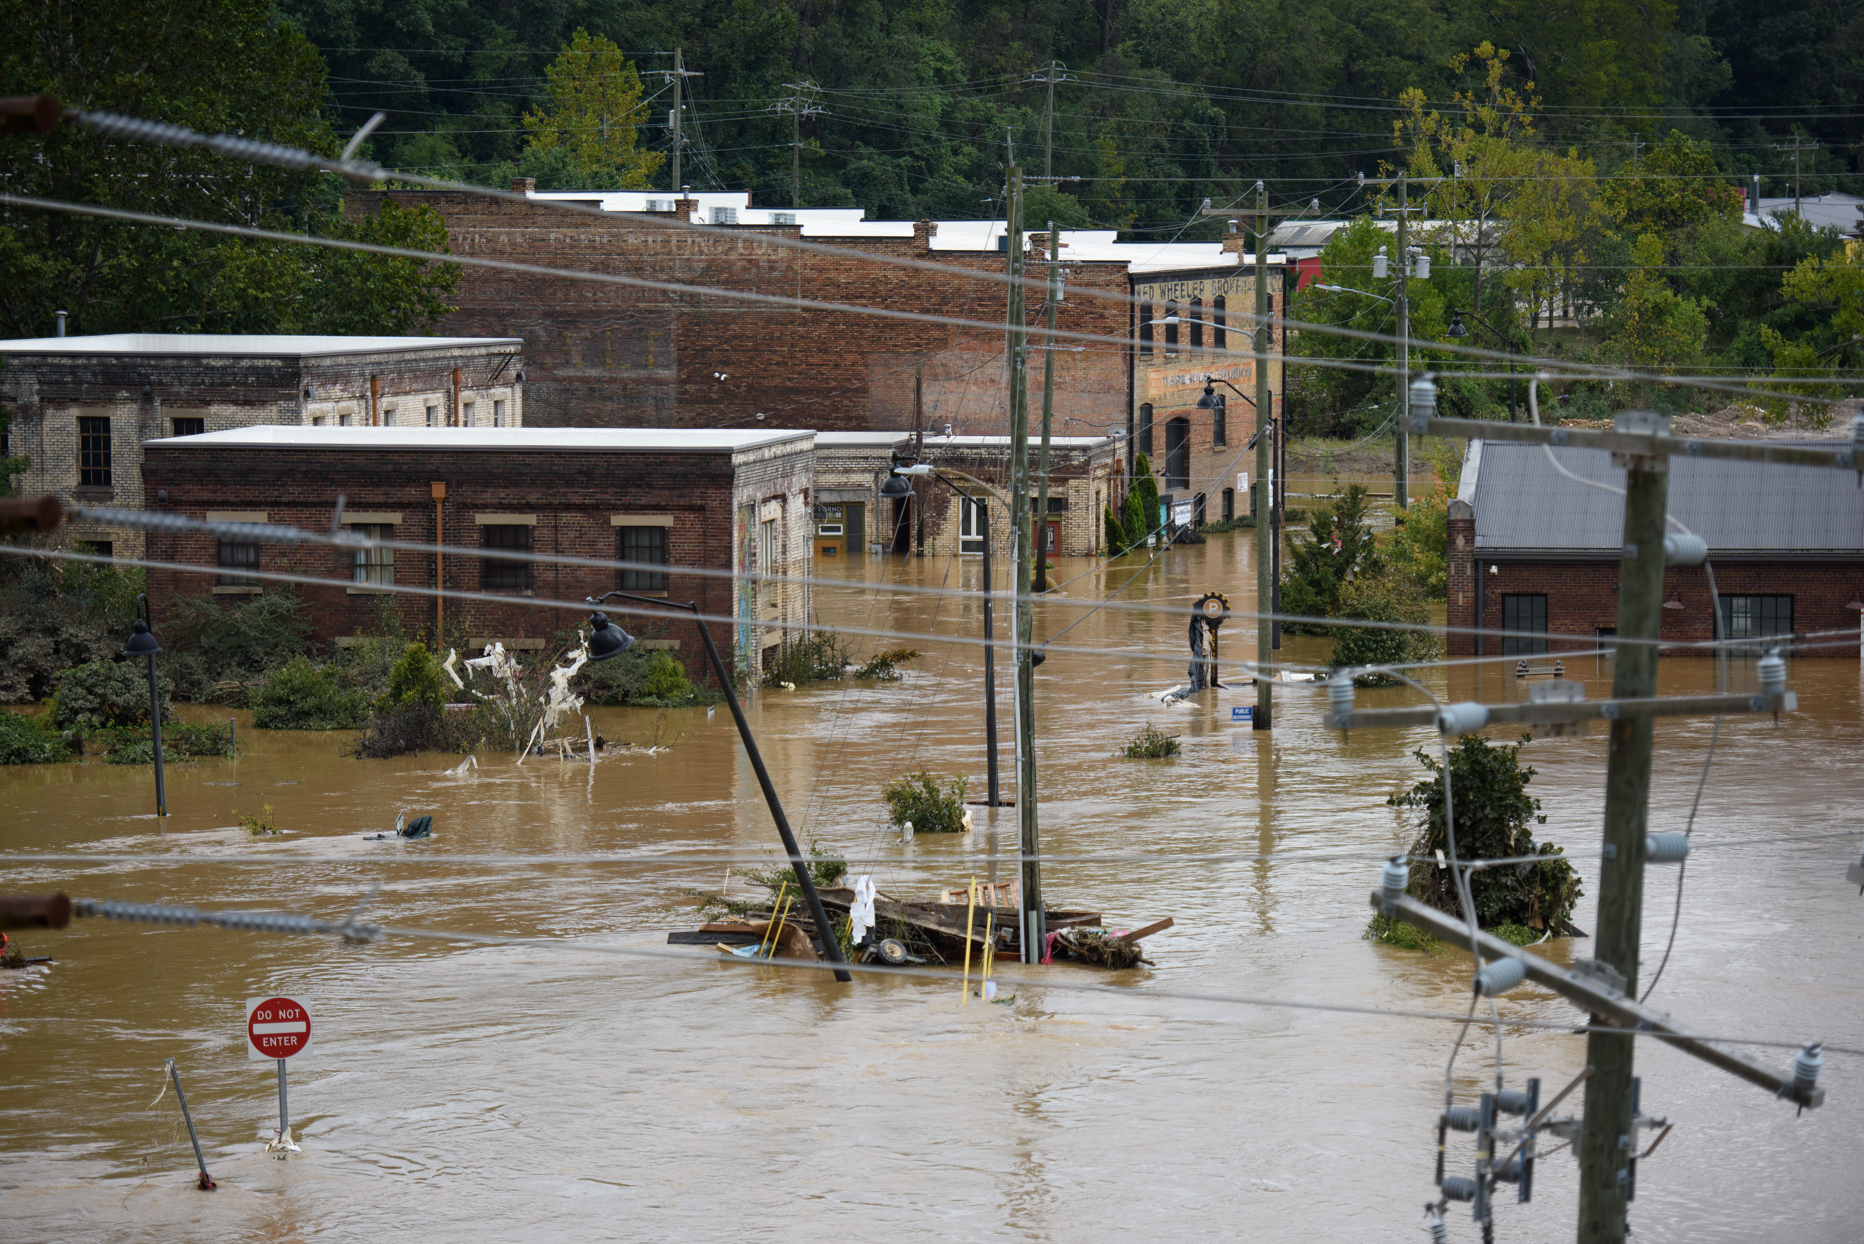
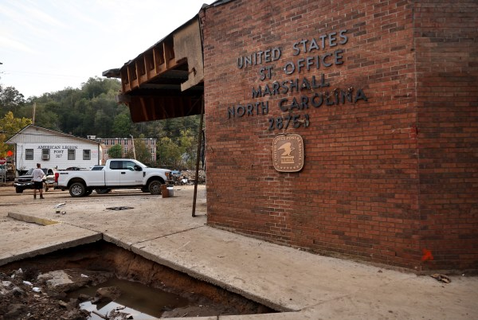
Delivering Voting Through Helene & High Water
Affected counties outpaced EV turnout
2% points higher
300 affected voters delivered ABM ballot out of county (special Helene provision)

Slide 17
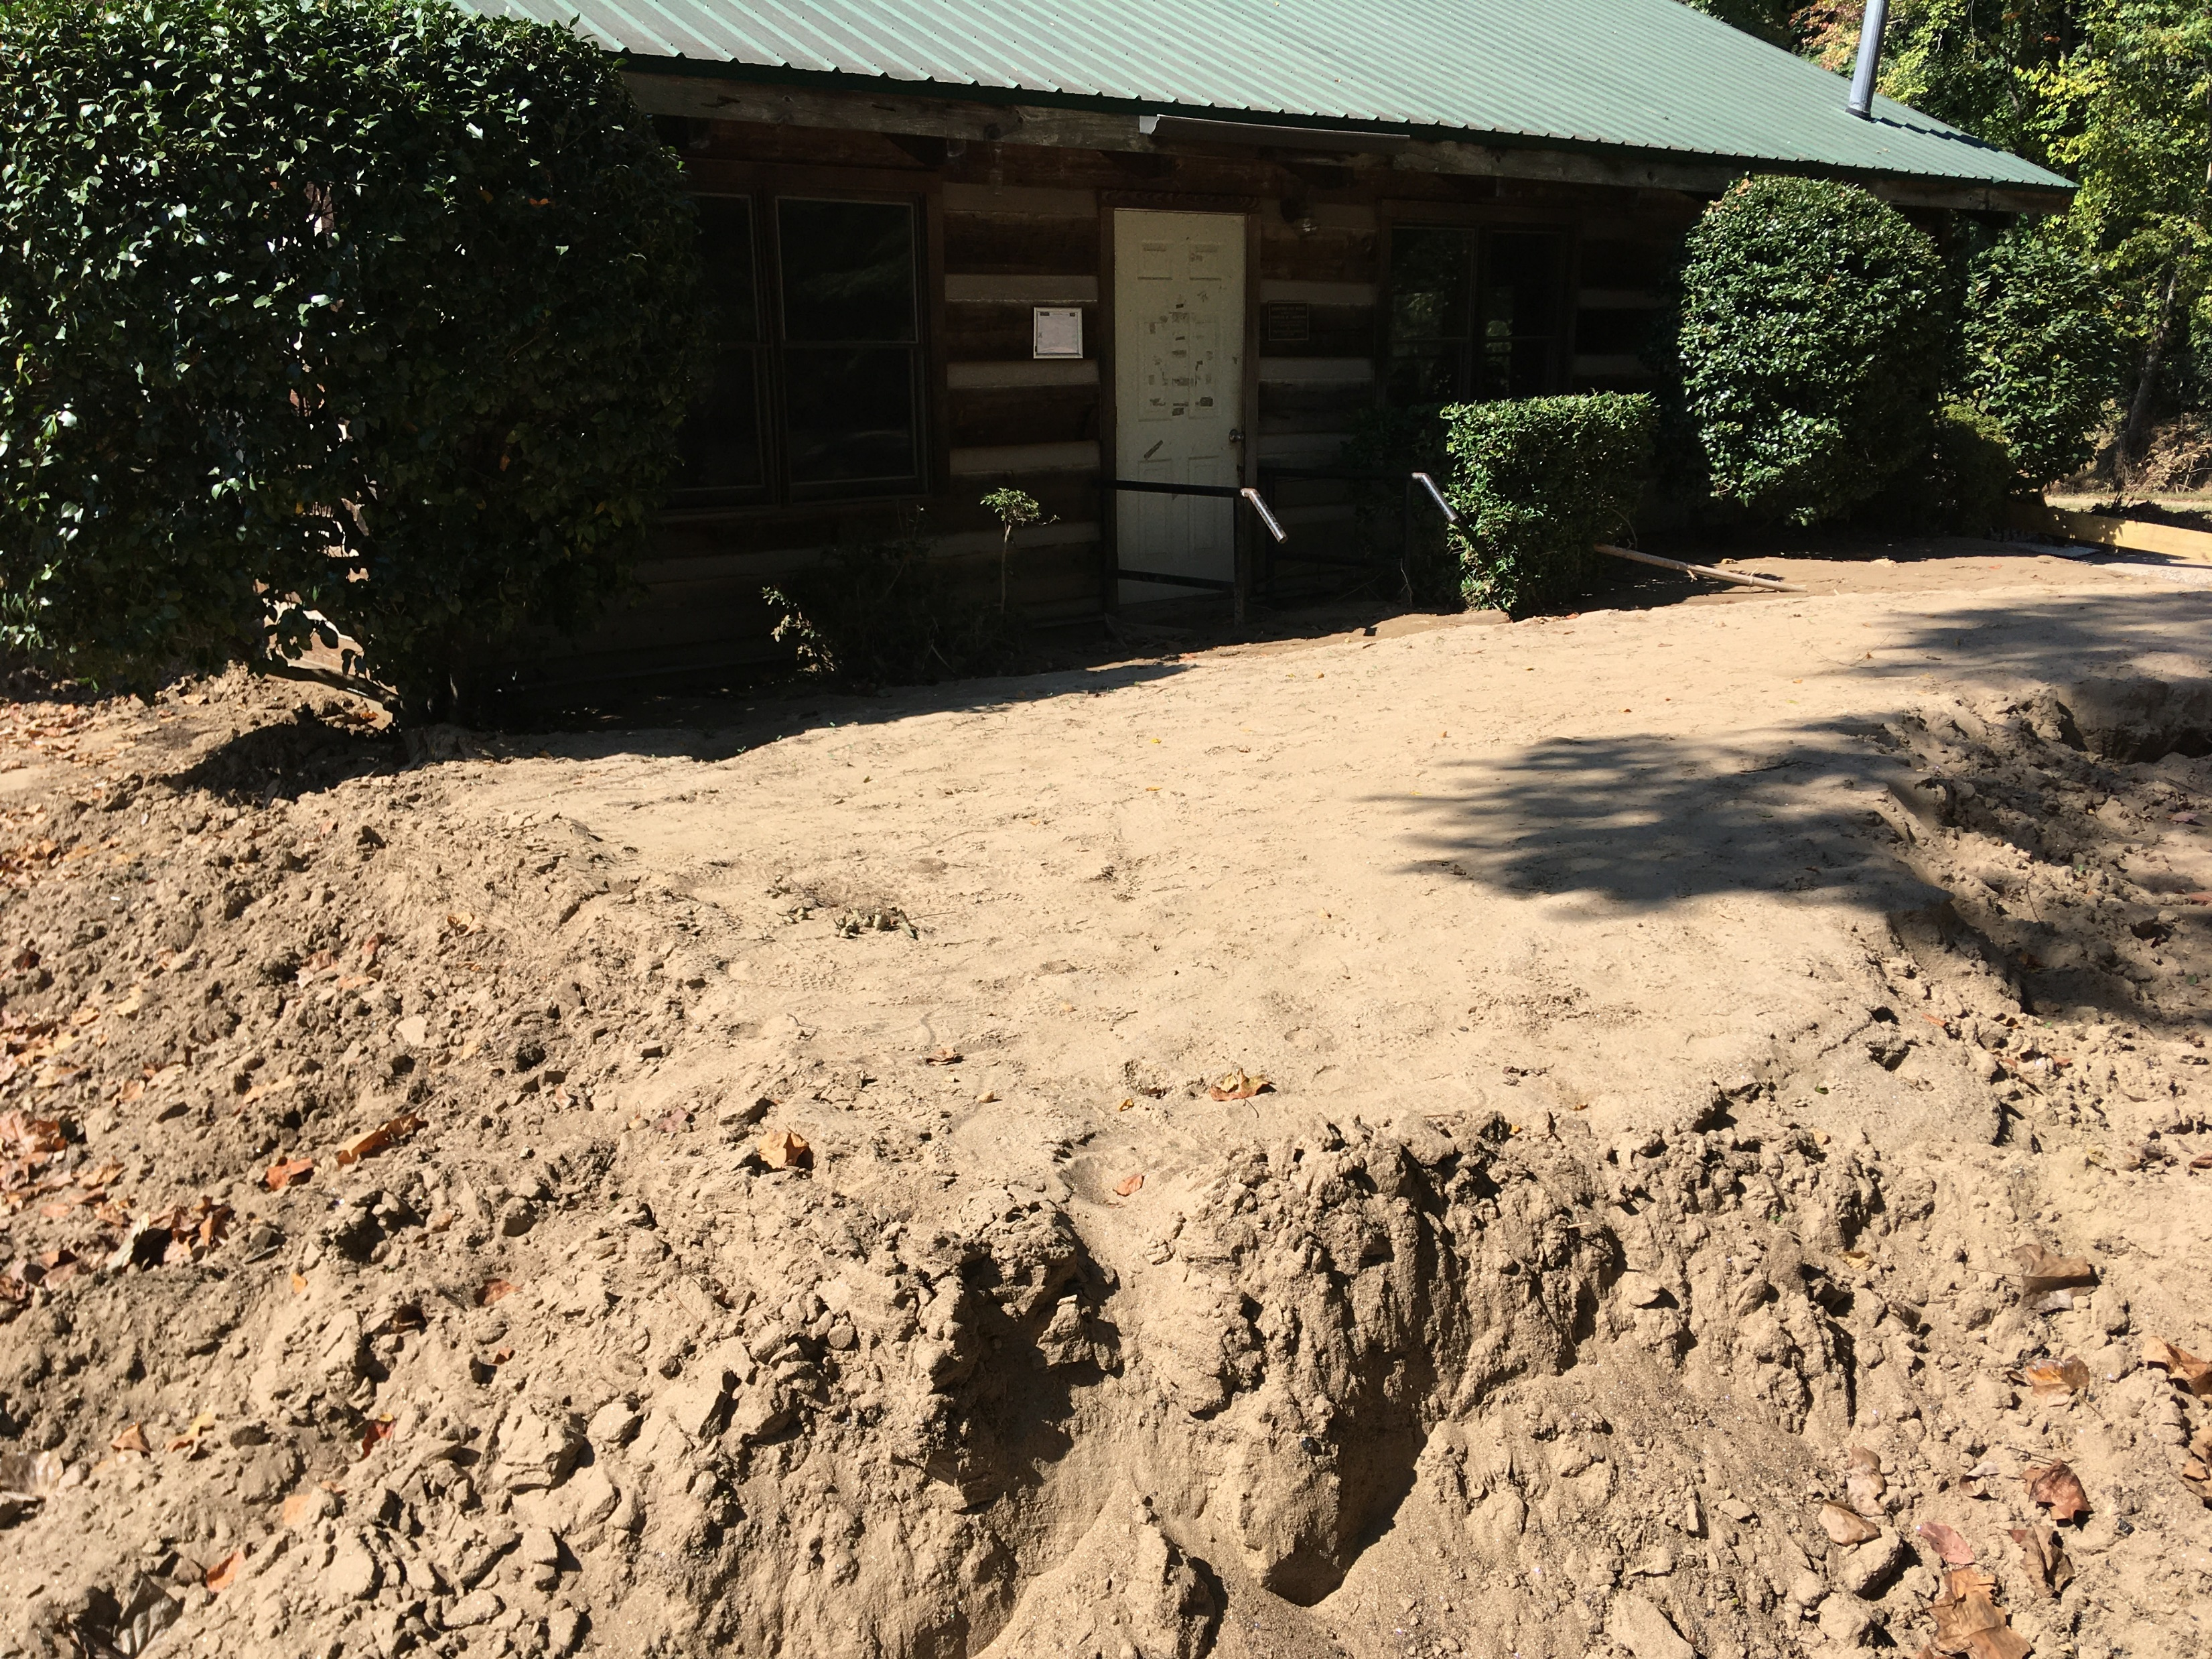
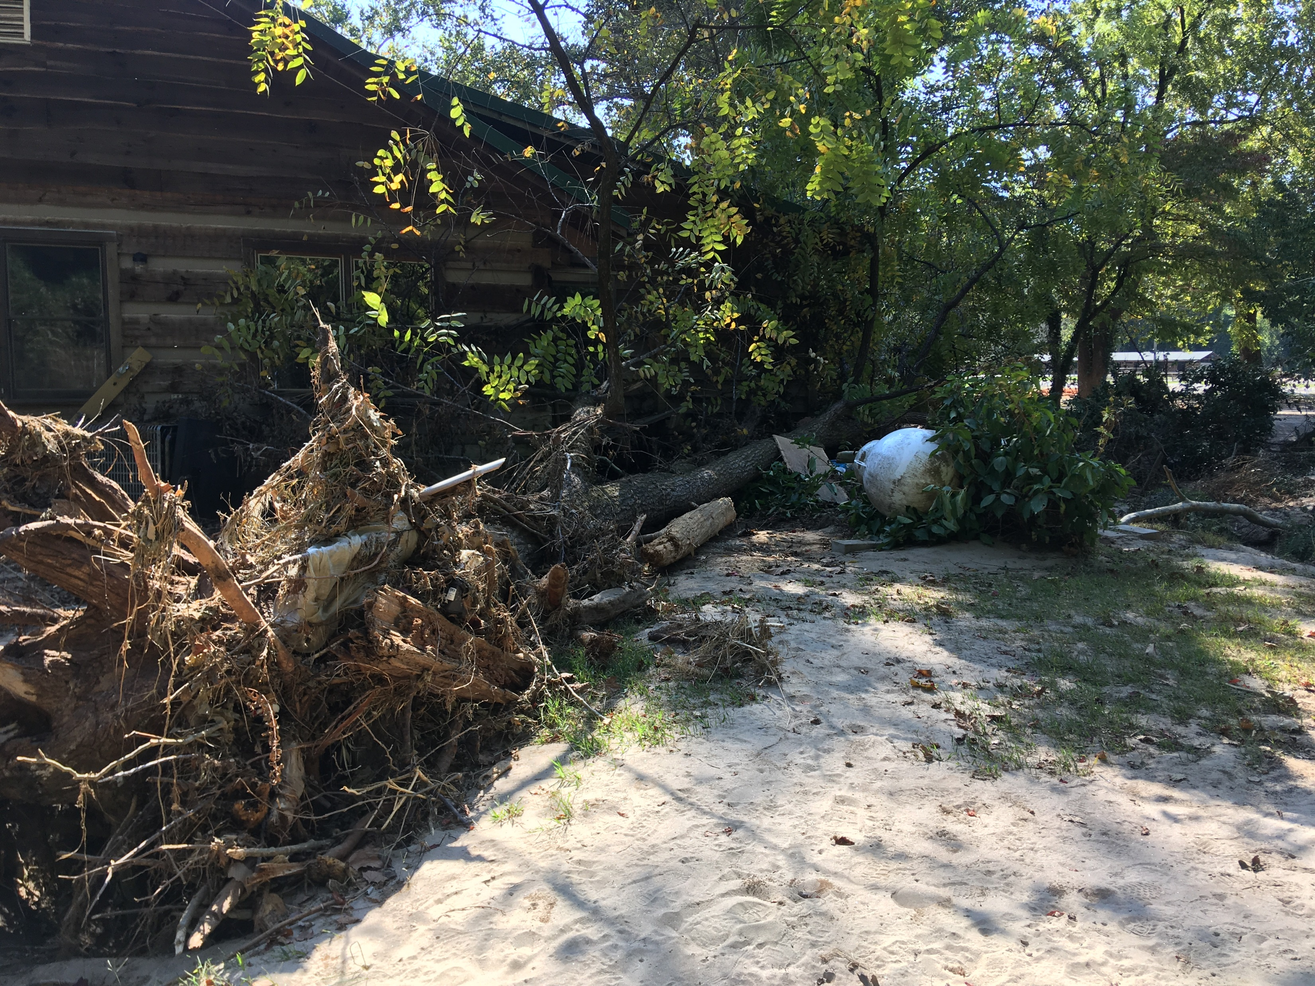
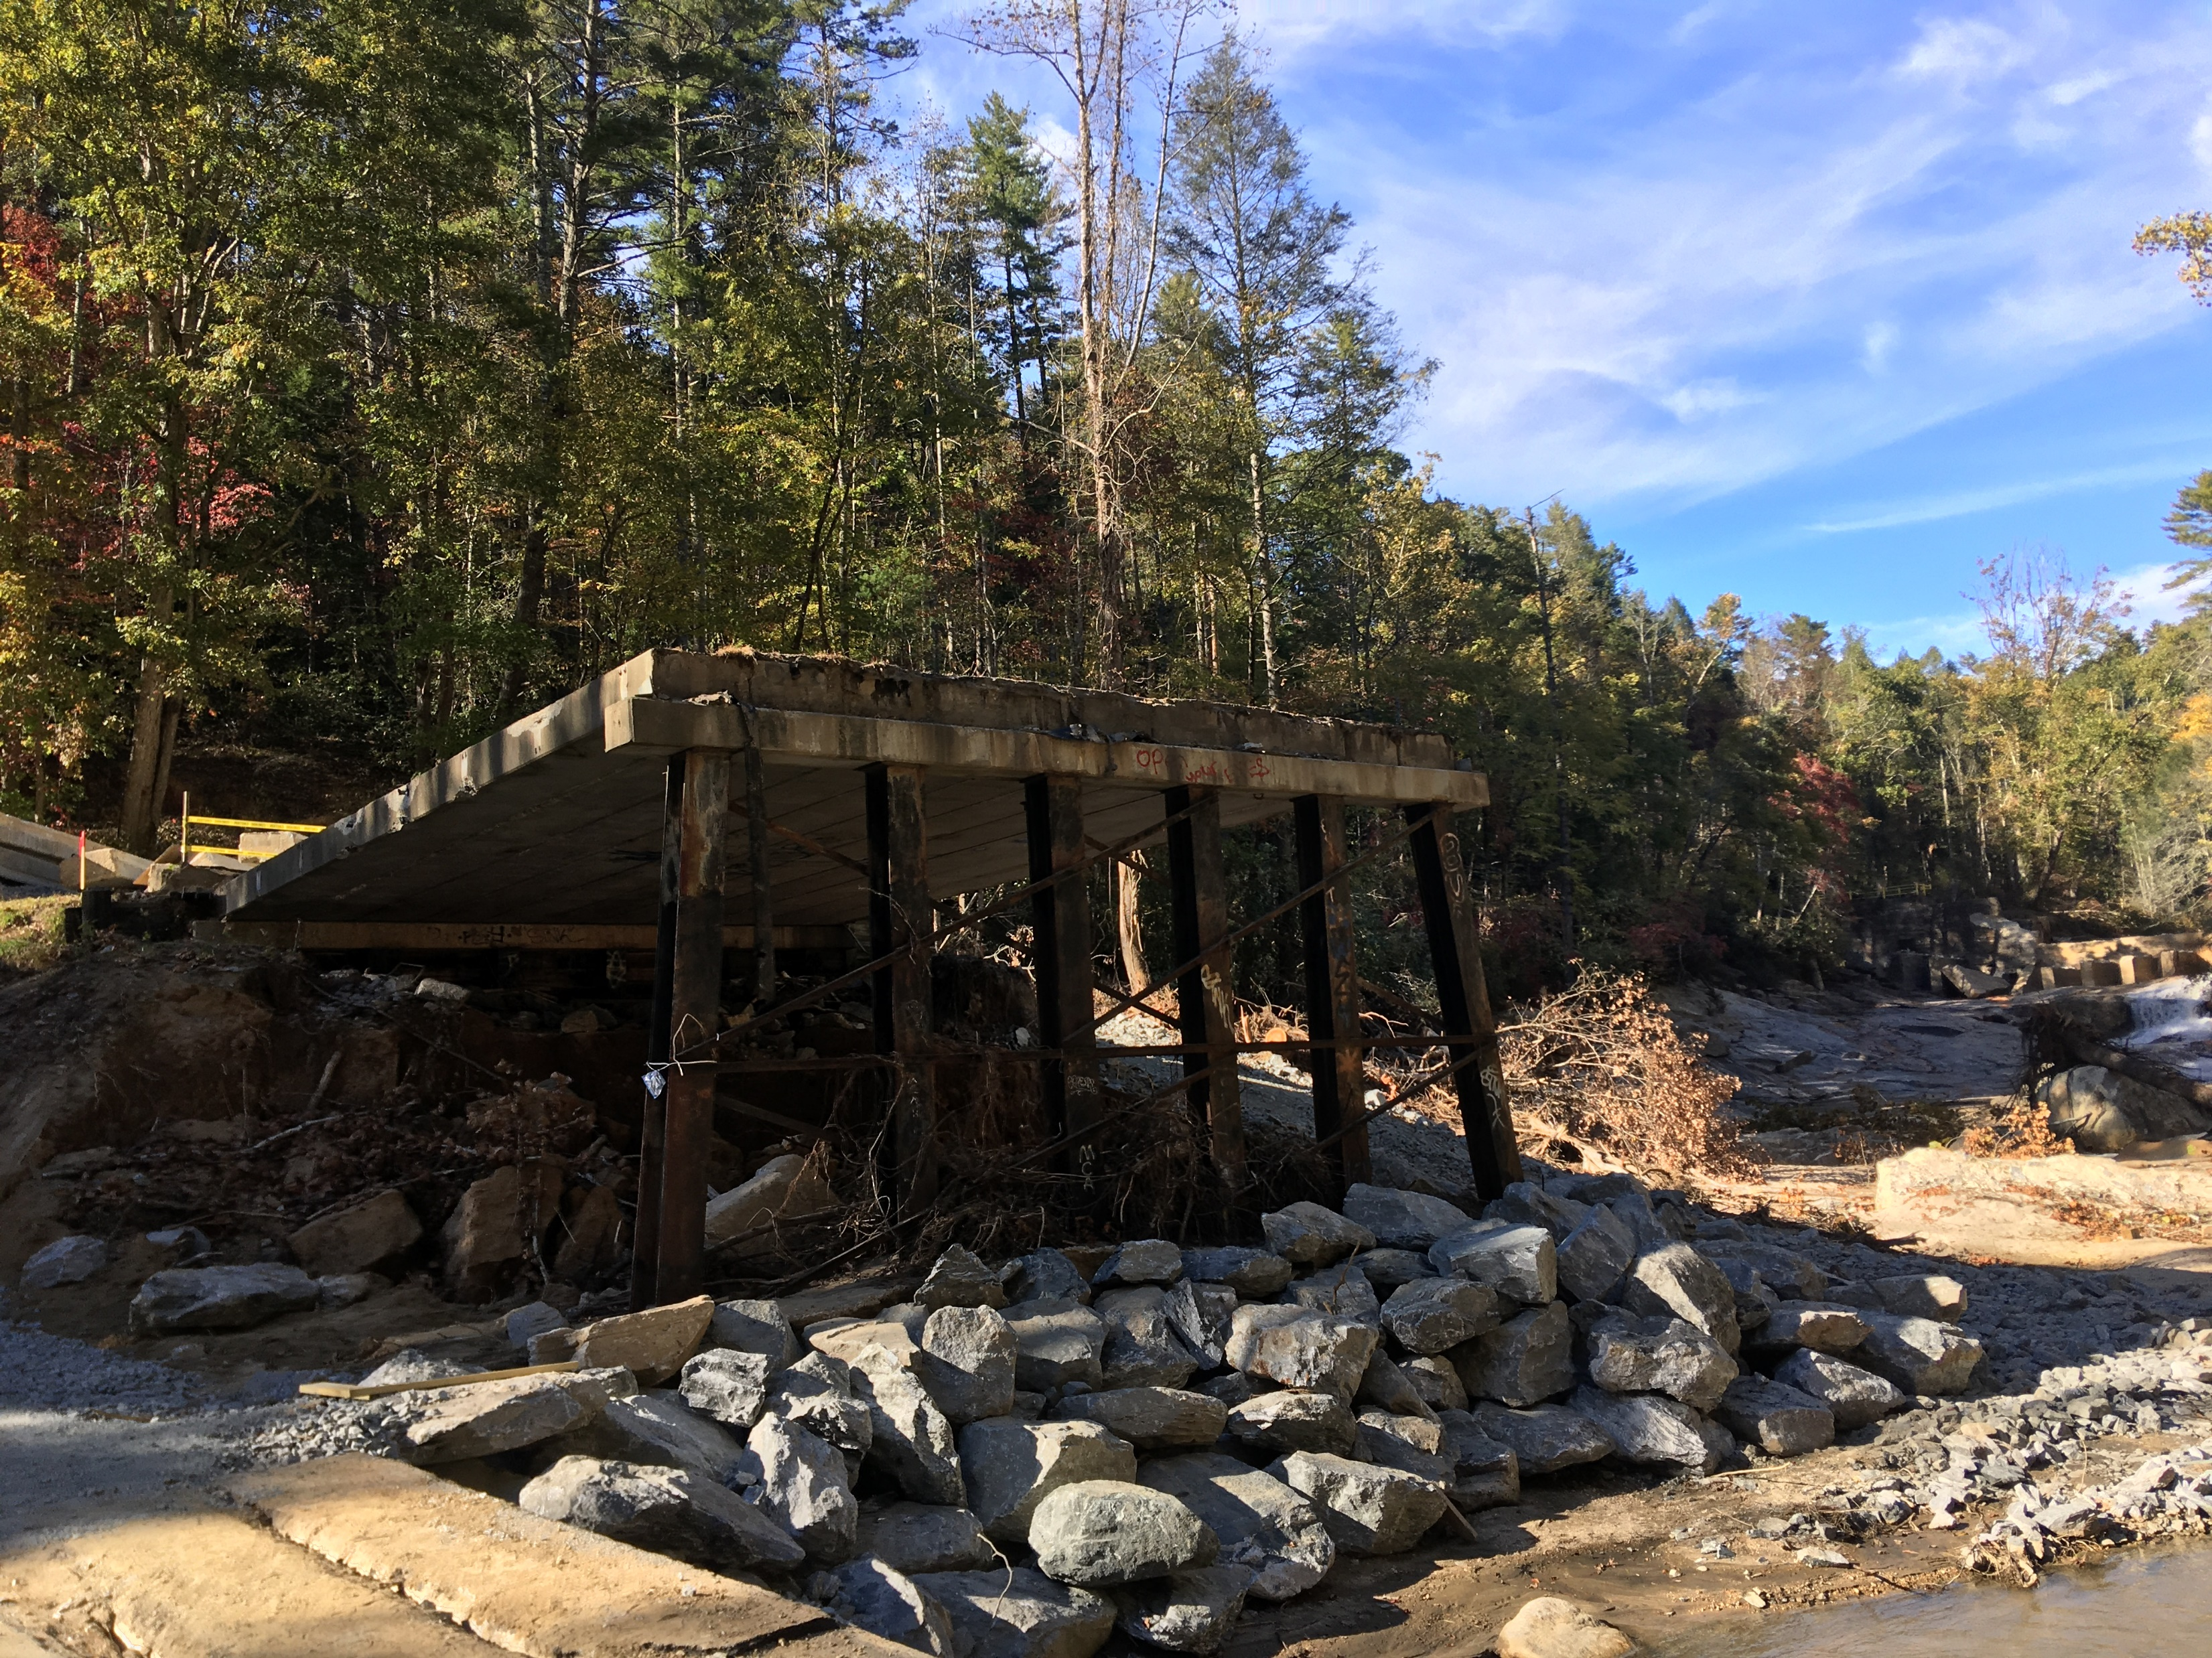
Delivering Voting Through Helene & High Water
Vast majority of Election Day sites were open
7 “blank slate tents” used: Yancey (4), Buncombe (1), Burke (1), Haywood (1)

Slide 18
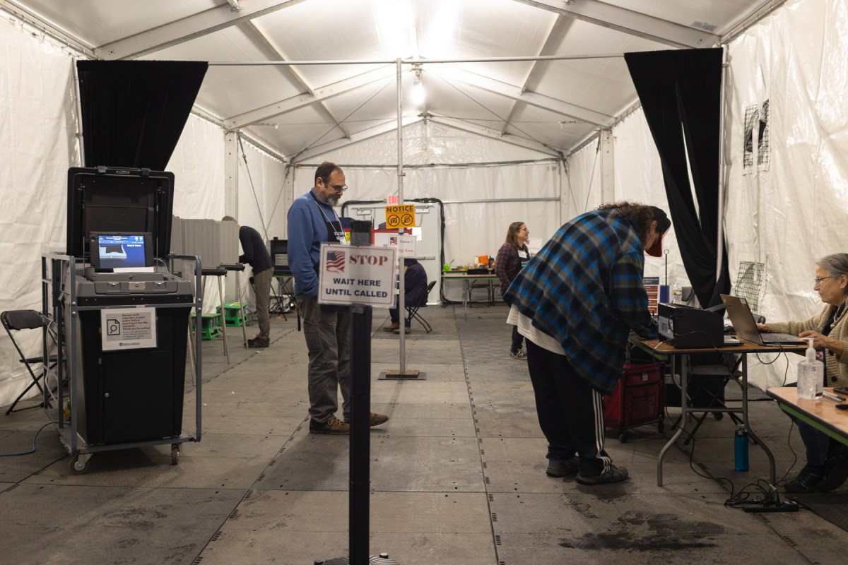
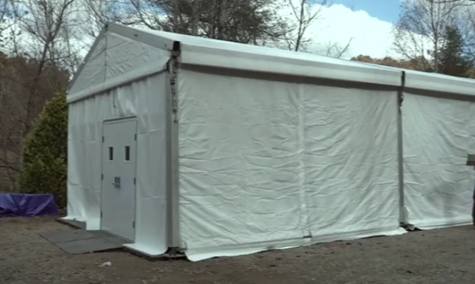
Delivering Voting Through Helene & High Water

Slide 19
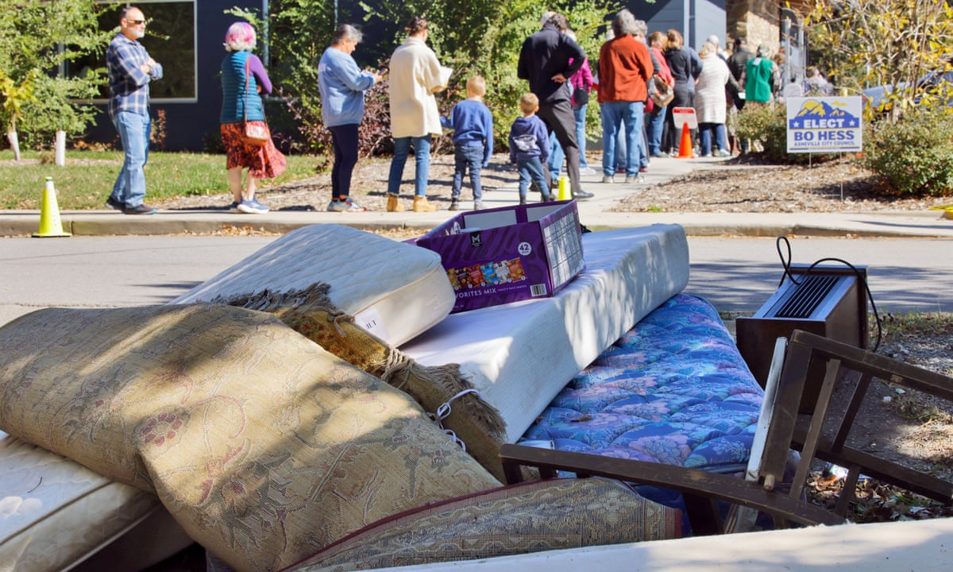
So how does the State Elections Office support the locals through major incidents?
No formula or perfect answer
Push the “insurance policy”
All hazards approach
Communicate, huddle, & execute the play
Make the asks
Use the bigger microphone
Be human not just business

Slide 20
Questions and Contact Information
Karen Brinson Bell, Executive Director
North Carolina State Board of Elections
karen.bell@ncsbe.gov

