Slide 1
Interpreter Skills for Elections
Somali

Slide 2
Goal for Tonight
Come together as a community of election judges sharing with each other to better serve Somali-speaking voters in Minneapolis

Slide 3
Introductions
Caryn
Charles
Table hosts: Ayan, Harun, Abshir, AK

Slide 4
Goals of interpreting for elections
Provide accurate, neutral information
Listen with attention, build trust
Develop communication and voter skills
Success measure
Somali-speaking voters in Minneapolis feel supported in voting

Slide 5
DON’Ts
Don’t interpret if you don’t want to. It isn’t required.
Don’t tell a voter what choices to make on a ballot.
Don’t discuss your political opinions or knowledge.

Slide 6
DOs
Listen to understand the voter’s questions.
Apply the rules and procedures of a polling place.
Help the voter navigate the process.
Communicate the right answers to the voter.

Slide 7
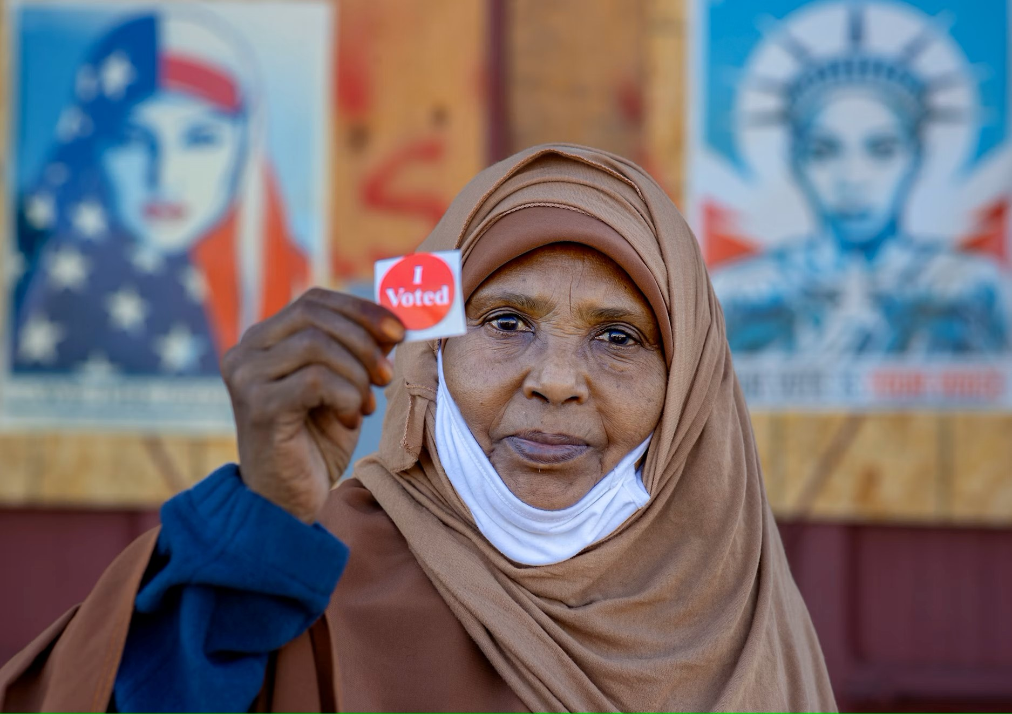
Service to the Community
You are a public servant helping all community members
Our hope: each person we serve feels empowered and informed as they vote

Slide 8
Ethics: Behavior in Actions
An interpreter is a neutral, nonpartisan position
We communicate through our words and actions that we are nonpartisan and impartial, we have no bias, and we support the democratic process for everyone

Slide 9
Election Judge Oath
I solemnly swear (or affirm) that I will perform the duties of Election Judge according to law and the best of my ability and will diligently endeavor to prevent fraud, deceit, and abuse in conducting this election. I will perform my duties in a fair and impartial manner and not attempt to create an advantage for my party or for any candidate.

Slide 10
Conduct: Carry out best practices
Help voters when requested and step away when they no longer need you.
If you don’t know a word or phrase, describe it, or rephrase it in English first, so that the voter fully understands.

Slide 11
Conduct: Body Language
Stay close enough that you can keep your voice low for privacy.
Don’t be so close you make them uncomfortable
Don’t watch who they vote for.
Appear relaxed and confident.

Slide 12
I will do all I can within the law to help you vote today.

Slide 13
How to be an election interpreter
Listen to determine what information the voter needs.
Answer carefully so that they will trust the process and can vote confidently and independently.
Ensure that you stay neutral.
Do not prompt the voter to choose any particular candidate or political party.

Slide 14
Election Day Scenarios

Slide 15
I want to check in (right precinct)

Slide 16
I want to register (right precinct)

Slide 17
I want to check in (wrong precinct)

Slide 18
I want to register (wrong precinct)

Slide 19
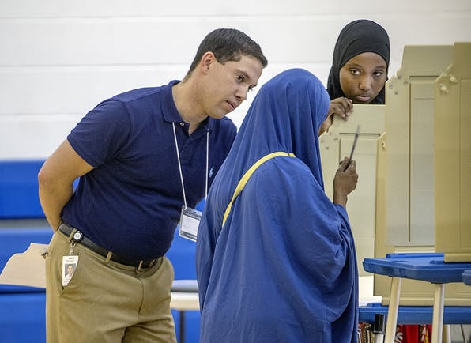
Party Balance Tasks Require judges from two major parties

Slide 20
Party Balance Tasks
Student judges and others not aligned with a party have two judges of different parties watch when interpreting for these tasks.
Marking a ballot
Curbside voting

Slide 21
Marking a ballot
Read all candidates to the voter, unless they tell you right away who they want.
If a voter makes a mistake, they can get a new ballot.
When done, offer to read back the choices they made.

Slide 22
Asking for too much information Who should I vote for? Can you do this for me?

Slide 23
Ballot error The ballot counter finds an error on the ballot. Explain how to fix the problem.

Slide 24
You are not alone
We have a hotline to a professional interpreting service.
Your head judges will support you, answer questions, solve problems.
Training covers procedures in detail.
Check your training manual.

Slide 25
Campaign Workers
Like you, campaign workers have to follow rules.
Communicate and enforce boundaries.
They can help voters if the voter wants them to. We work for the voter.
If another voter or helper interferes, ask head judge team for help.

Slide 26
Sample ballots & campaign flyers Are voters allowed to use them? What are the limits?

Slide 27
Voter brings a mail ballot What should you do? What should the voter do?

Slide 28
People are nice, usually A voter treats you rudely, being impolite and disruptive.

Slide 29
Inappropriate behavior
You deserve to be respected.
Your safety is absolutely important to us.

Slide 30
Interpreting best practices
As a neutral party, we do not want to mislead or make decisions for the voter—which would be unethical and, in some cases, illegal.

Slide 31
Activity: Helping fellow interpreters
Not everyone who is interpreting for Somali voters could be here tonight. What will you tell others in your precinct about interpreting for voters?

Slide 32
Listening
Make sure you are hearing voters correctly – confirm what you have heard.
It may be helpful to phrase it differently if you’re unsure you understood.

Slide 33
Speaking
Adjust your volume so you can be heard without being overheard in a crowded room.
Privacy matters, even if using a language others in the room may not share.
Pronounce carefully.
Use simple words, don’t obfuscate unnecessarily.

Slide 34
Give space and time
Do not rush, ever.
Save space for questions or explanations.
Speaking more slowly helps people understand you more clearly.
Show patience and willingness to adjust your style or the information you provide, etc.

Slide 35
Summary
All voters should feel welcome to request help when they need it—never assume someone needs support.
Personal and data privacy is a priority
Let the voter make their own decisions and speak with their own ballot.

Slide 36
Thank you
Your service is more important than ever
You really do make a difference
Helping people vote
Let’s go make history together!

Slide 37
This is a collaboration
Minneapolis Elections
Salma Abdirahman
Harun Abukar
Abshir Mohamed
Ridwan Mohamed Yonis Muse
Charles Piehl
Caryn Scheel
Ayan Shire
311 Service Center
Breanna Phelps
Ubah Academy
Faysal Ali
Jessica Julius
Joel Coleman
Ramsey County Elections
Emily Hunt
YCB
Rachel​ Oberg-Hauser
Sadam Noor

Slide 38
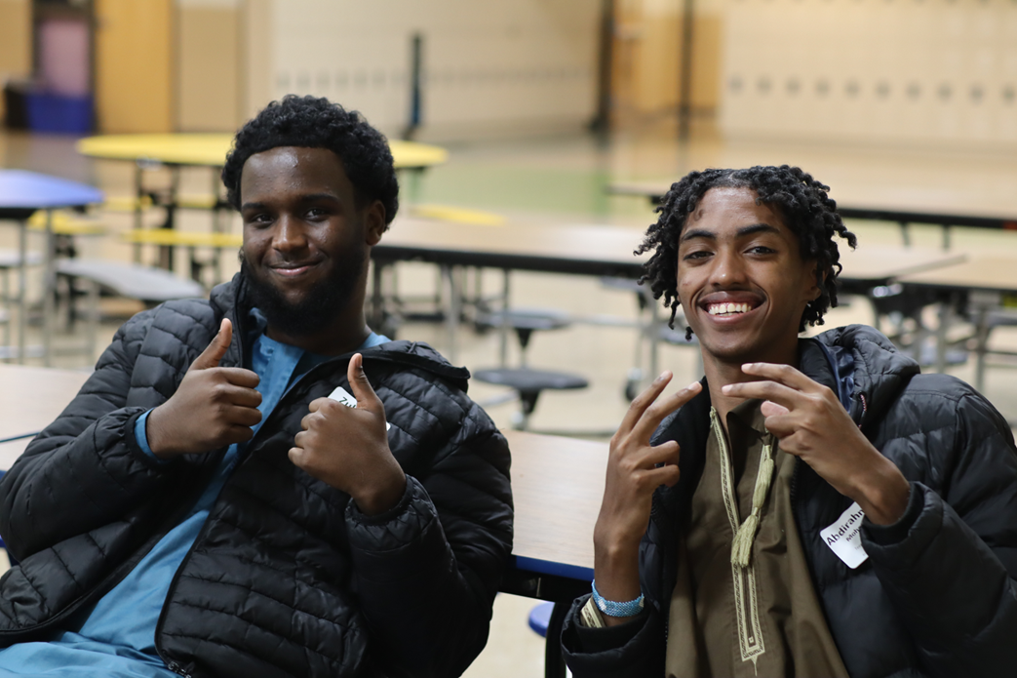
Announcements

